Slide 1
Machine Learning 2024 (ML-2024) Lecture 13. Unsupervised learning
by Alexei Valerievich Kornaev, Dr. habil. in Eng. Sc., Researcher at the RC for AI, Assoc. Prof. of the Robotics and CV Master’s Program, Innopolis University
Researcher at the RC for AI, National RC for Oncology n.a. NN Blohin
Professor at the Dept. of Mechatronics, Mechanics, and Robotics, Orel State University

Slide 2
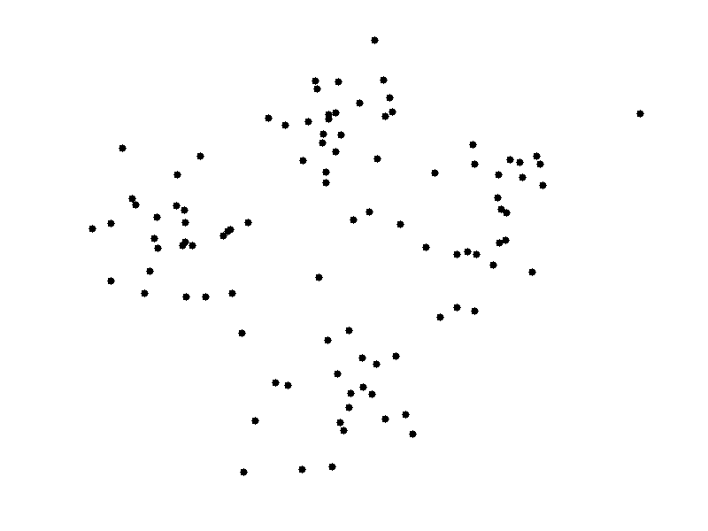

Agenda
ML-2024 by Alexei Kornaev
INTRO TO UNSUPERVISED LEARNING
CLUSTERING
DIMENSIONALITY REDUCTION
AUTOENCODERS
VARIATIONAL AUTOENCODERS
DIFFUSION MODELS
HANDS-ON SESSION
CONCLUSION

Slide 3
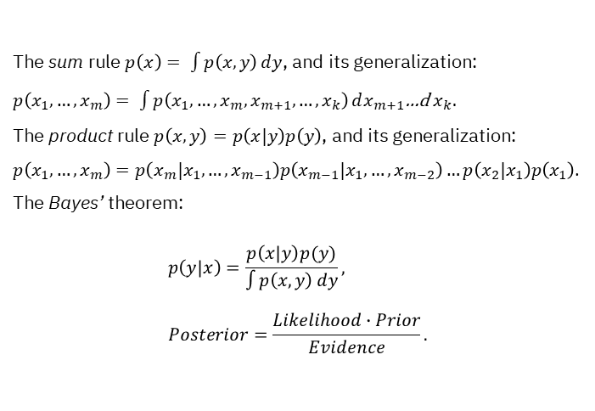
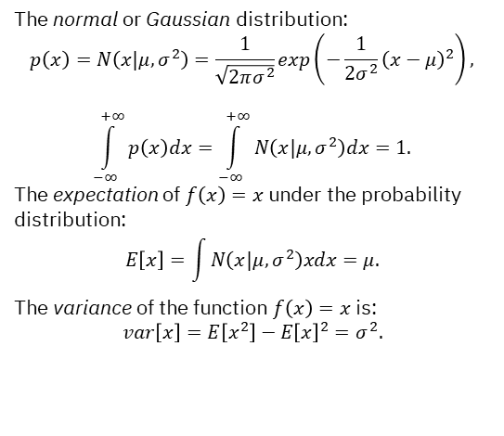
ML-2024 by Alexei Kornaev
Recap: probability distributions
The sum rule $p\left(x\right)= \int{p\left(x,y\right)}dy$, and its generalization: $p\left(x_{1},…,x_{m}\right)= \int{p\left(x_{1},…,x_{m},x_{m+1},…,x_{k}\right)}dx_{m+1}$…d $x_{k}.$
The product rule $p\left(x,y\right)=p\left(x|y\right)p\left(y\right)$, and its generalization: $p\left(x_{1},…,x_{m}\right)=p\left(x_{m}|x_{1},…,x_{m−1}\right)p\left(x_{m−1}|x_{1},…,x_{m−2}\right)…p\left(x_{2}|x_{1}\right)p\left(x_{1}\right)$.
The Bayes’ theorem: $$p\left(y|x\right)=\frac{p\left(x|y\right)p(y)}{\int{p\left(x,y\right)}dy}, \\ Posterior=\frac{Likelihood∙Prior}{Evidence}.$$
The normal or Gaussian distribution:
$$p\left(x\right)=N\left(x|μ,σ^{2}\right)=\frac{1}{\sqrt{2πσ^{2}}}exp\left(−\frac{1}{2σ^{2}}{\left(x−μ\right)}^{2}\right),$$ $$\int_{−∞}^{+∞}{p\left(x\right)dx}=\int_{−∞}^{+∞}{N\left(x|μ,σ^{2}\right)dx}=1.$$
The expectation of $f\left(x\right)=x$ under the probability distribution: $$E\left[x\right]=\int{N\left(x|μ,σ^{2}\right)xdx}=μ.$$
The variance of the function $f\left(x\right)=x$ is: $$var\left[x\right]=E\left[x^{2}\right]−{E\left[x\right]}^{2}=σ^{2}.$$
Pattern Recognition and Machine Learning by Ch. Bishop, 2006
3

Slide 4
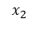
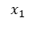
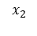
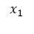
ML-2024 by Alexei Kornaev
Recap: decision making in ML
ML
Unsupervised learning
Reinforcement learning
Supervised learning
$$x_{2}$$
$$x_{2}$$
$$x_{1}$$
$$x_{1}$$
4

Slide 5
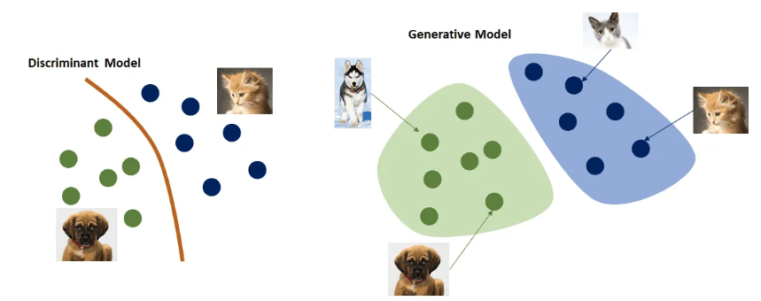
ML-2024 by Alexei Kornaev
Discriminative vs Generative models
A discriminative model intuition: given $\left(x, y\right)$, find a distribution $p\left(y | x\right)$ to make a prediction $h$
A generative model intuition: given $y$, find a distribution $p\left(x | y\right)$ or $p$($x$) to make a sampling $x$ from the distribution
Yandex Handbook on ML
5

Slide 6
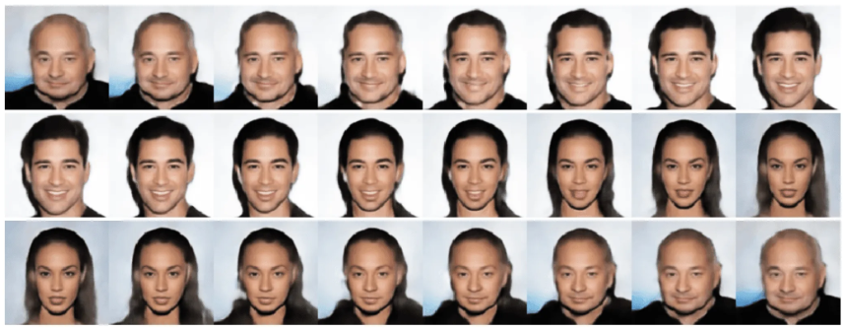
ML-2024 by Alexei Kornaev
Generative models: interpolation in a latent space
Given a latent space characterized with a vector $z$. Two samples $x^{(1)}=G(z^{(1)})$ and $x^{(2)}=G(z^{(2)})$ generated from the latent space can be connected with the line which corresponds with a set of interpolation points and samples $x^{(i)}=G(z^{(i)})$.
Yandex Handbook on ML
6

Slide 7
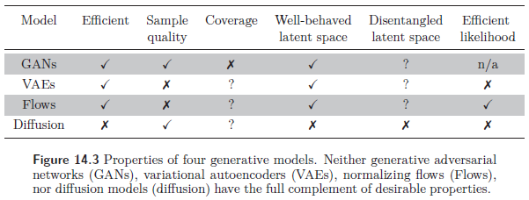
ML-2024 by Alexei Kornaev
Generative models: what makes a good one?
• Efficient sampling: Generating samples from the model should be computationally inexpensive and take advantage of the parallelism.
• High-quality sampling: The samples should be indistinguishable from the real data with which the model was trained.
• Coverage: Samples should represent the entire training distribution. It is insufficient to generate samples that all look like a subset of the training examples.
• Well-behaved latent space: A latent variable z corresponds to a plausible data example x. Smooth changes in z correspond to smooth changes in x.
• Disentangled latent space: Manipulating each dimension of z should correspond to changing an interpretable property of the data. For example, in a model of language, it might change the topic, tense, or verbosity.
• Efficient likelihood computation: If the model is probabilistic, we would like to be able to calculate the probability of new examples efficiently and accurately.
Simon J.D. Prince. Understanding Deep learning, MIT Press, 2024
7

Slide 8
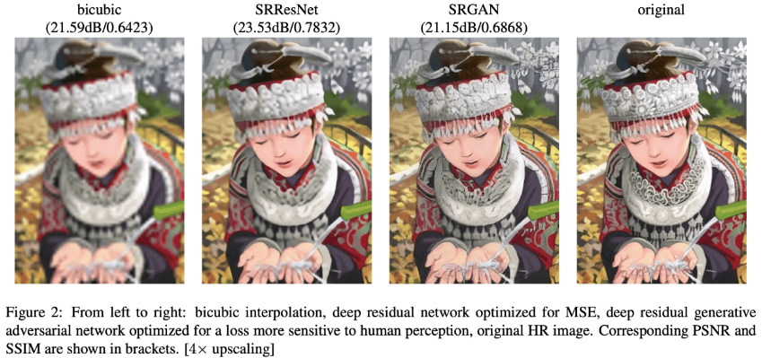
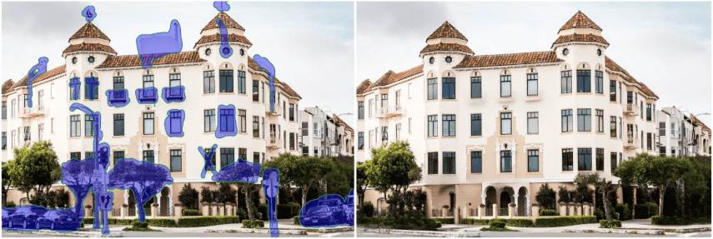

ML-2024 by Alexei Kornaev
Generative models: applications
Yandex Handbook on ML
8

Slide 9
Agenda
ML-2024 by Alexei Kornaev
INTRO TO UNSUPERVISED LEARNING
CLUSTERING
DIMENSIONALITY REDUCTION
AUTOENCODERS
VARIATIONAL AUTOENCODERS
DIFFUSION MODELS
HANDS-ON SESSION
CONCLUSION

Slide 10
Agenda
ML-2024 by Alexei Kornaev
INTRO TO UNSUPERVISED LEARNING
CLUSTERING
DIMENSIONALITY REDUCTION
AUTOENCODERS
VARIATIONAL AUTOENCODERS
DIFFUSION MODELS
HANDS-ON SESSION
CONCLUSION

Slide 11
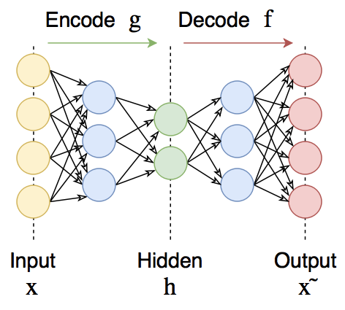
ML-2024 by Alexei Kornaev
AE architecture and intuition
Автоэнкодеры в Keras. Статья в Habr.
11

Slide 12
ML-2024 by Alexei Kornaev
AE algorithm
Step | Description
1. Data Preparation | - Input Data: Prepare the input data (e.g., images, text). - Normalization: Normalize the data if necessary. - Batching: Divide the data into batches for training.
2. Model Definition | - Encoder: Define the encoder part of the autoencoder, which compresses the input data into a lower-dimensional representation. - Decoder: Define the decoder part, which reconstructs the input data from the compressed representation.
3. Loss Function | - Reconstruction Loss: Choose a loss function to measure the difference between the input data and the reconstructed data (e.g., Mean Squared Error for continuous data, Cross-Entropy for binary data).
4. Optimization | - Optimizer: Choose an optimization algorithm (e.g., Adam, SGD) to minimize the loss function. - Learning Rate: Set the learning rate for the optimizer.
5. Training Loop | - Epochs: Set the number of epochs for training. - Batch Processing: For each epoch, iterate through the batches of data. - Forward Pass: Pass the input data through the encoder and decoder to get the reconstructed data. - Loss Calculation: Compute the loss between the input data and the reconstructed data. - Backward Pass: Compute the gradients of the loss with respect to the model parameters. - Parameter Update: Update the model parameters using the optimizer.
Deep Seek speaks
12

Slide 13
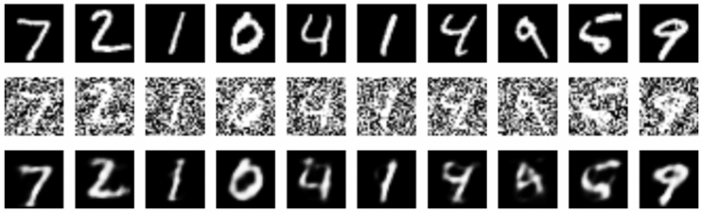
ML-2024 by Alexei Kornaev
AE applications
Автоэнкодеры в Keras. Статья в Habr.
13

Slide 14
Agenda
ML-2024 by Alexei Kornaev
INTRO TO UNSUPERVISED LEARNING
CLUSTERING
DIMENSIONALITY REDUCTION
AUTOENCODERS
VARIATIONAL AUTOENCODERS
DIFFUSION MODELS
HANDS-ON SESSION
CONCLUSION

Slide 15
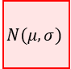
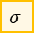

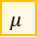

ML-2024 by Alexei Kornaev
VAE: intuition
The main task of a generative model is to learn the underlying distribution of the input data and generate new data samples that are similar to the original data. In essence, generative models aim to model the data-generating process, allowing them to produce synthetic data that mimics the characteristics and patterns of the real data.
Encoder
Decoder
Encoder
Decoder
$$z$$
$$μ$$
$$N(μ, σ)$$
$$z$$
$$\sim$$
$$σ$$
$$z$$
$$z$$
AE (left) and VAE (right) intuition
15

Slide 16
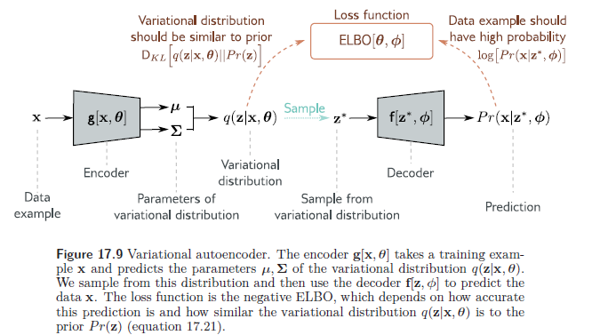
ML-2024 by Alexei Kornaev
VAE: intuition
The main task of a generative model is to learn the underlying distribution of the input data and generate new data samples that are similar to the original data. In essence, generative models aim to model the data-generating process, allowing them to produce synthetic data that mimics the characteristics and patterns of the real data.
Simon J.D. Prince. Understanding Deep learning, MIT Press, 2024
16

Slide 17
ML-2024 by Alexei Kornaev
VAE: algorithm
Step | Description
1. Data Preparation | - Prepare input data (e.g., images, text). - Normalize data if necessary. - Divide data into batches.
2. Model Definition | - Encoder: Map input data to latent distribution parameters (mean μμ and log variance log⁡σ2logσ2). - Reparameterization Trick: Sample latent vector zz using z=μ+σ⋅ϵz=μ+σ⋅ϵ. - Decoder: Map latent vector zz back to data space.
3. Loss Function | - Reconstruction Loss: Measure difference between input and reconstructed data (e.g., MSE for continuous, BCE for binary). - KL Divergence: Measure difference between learned latent distribution and prior distribution (standard normal). - Total Loss: Combine reconstruction loss and KL divergence.
4. Optimization | - Choose optimizer (e.g., Adam, SGD). - Set learning rate.
5. Training Loop | - Set number of epochs. - Iterate through batches: 1. Encoding: Obtain μμ and log⁡σ2logσ2. 2. Sampling: Use reparameterization trick to sample zz. 3. Decoding: Reconstruct data. 4. Loss Calculation: Compute reconstruction loss and KL divergence. 5. Backward Pass: Compute gradients and update parameters. - Optionally, log loss values.
Deep Seek speaks
17

Slide 18
ML-2024 by Alexei Kornaev
AE vs VAE: architecture
Feature | Autoencoder (AE) | Variational Autoencoder (VAE)
Objective | Learn a compressed representation (encoding) of the input data. | Learn a probabilistic model of the data distribution in the latent space.
Latent Space | Deterministic: Each input is mapped to a single point in the latent space. | Stochastic: Each input is mapped to a distribution (usually Gaussian) in the latent space.
Encoder | Outputs a single vector (encoding) for each input. | Outputs parameters of a distribution (mean and variance) for each input.
Decoder | Takes the encoding as input and reconstructs the original data. | Takes a sample from the latent distribution (reparameterization trick) and reconstructs the original data.
Loss Function | Reconstruction loss (e.g., Mean Squared Error) to measure the difference between the input and the reconstructed data. | Combination of reconstruction loss and KL divergence to ensure the latent distribution matches a prior distribution (usually standard normal).
Deep Seek speaks
18

Slide 19
ML-2024 by Alexei Kornaev
AE vs VAE: training process
Feature | Autoencoder (AE) | Variational Autoencoder (VAE)
Training Objective | Minimize the reconstruction error. | Minimize the reconstruction error and the KL divergence between the learned latent distribution and the prior distribution.
Reparameterization Trick | Not used. | Used to make the sampling process differentiable, allowing backpropagation through the latent space.
Regularization | Typically not regularized (unless using techniques like dropout). | Regularized to ensure the latent space is smooth and continuous, allowing for meaningful interpolation and generation of new data points.
Deep Seek speaks
19

Slide 20
ML-2024 by Alexei Kornaev
AE vs VAE: applications
Feature | Autoencoder (AE) | Variational Autoencoder (VAE)
Dimensionality Reduction | Yes, AE can be used for dimensionality reduction by extracting the encoding. | Yes, VAE can also be used for dimensionality reduction, but the latent space is more structured and interpretable.
Data Generation | No, AE cannot generate new data points because the latent space is deterministic. | Yes, VAE can generate new data points by sampling from the latent space and decoding the samples.
Anomaly Detection | Yes, AE can be used for anomaly detection by identifying inputs with high reconstruction error. | Yes, VAE can also be used for anomaly detection, but the probabilistic nature of the latent space can provide additional insights.
Interpolation | Limited, as the latent space is not guaranteed to be smooth. | Better, as the latent space is regularized to be smooth and continuous, allowing for meaningful interpolation between data points.
Deep Seek speaks
20

Slide 21
ML-2024 by Alexei Kornaev
Frequentist vs Bayesian frameworks
Certainly! Here's a comprehensive agenda for a lecture on unsupervised learning, with a focus on Variational Autoencoders (VAEs) and Diffusion Models:
### Agenda: Unsupervised Learning with VAEs and Diffusion Models
#### 1. **Introduction to Unsupervised Learning** (10 minutes)
- **Definition and Importance**: What is unsupervised learning? Why is it important?
- **Types of Unsupervised Learning**: Clustering, Dimensionality Reduction, Generative Models.
- **Applications**: Real-world applications of unsupervised learning.
#### 2. **Clustering Techniques** (15 minutes)
- **K-Means Clustering**: Algorithm, Advantages, and Limitations.
- **Hierarchical Clustering**: Agglomerative and Divisive methods.
- **Density-Based Clustering**: DBSCAN, OPTICS.
#### 3. **Dimensionality Reduction** (15 minutes)
- **Principal Component Analysis (PCA)**: Theory and Implementation.
- **t-Distributed Stochastic Neighbor Embedding (t-SNE)**: Visualization technique.
- **Uniform Manifold Approximation and Projection (UMAP)**: Comparison with t-SNE.
#### 4. **Introduction to Generative Models** (10 minutes)
- **Generative vs. Discriminative Models**: Key differences.
- **Common Generative Models**: GANs, VAEs, Diffusion Models.
#### 5. **Variational Autoencoders (VAEs)** (20 minutes)
- **Basic Concepts**: Autoencoders, Latent Space, Reconstruction Error.
- **Variational Inference**: ELBO (Evidence Lower Bound), KL Divergence.
- **Training VAEs**: Loss Function, Backpropagation.
- **Applications**: Image Generation, Anomaly Detection.
#### 6. **Diffusion Models** (20 minutes)
- **Basic Concepts**: Forward and Reverse Diffusion Processes.
- **Mathematical Framework**: Stochastic Differential Equations (SDEs).
- **Training Diffusion Models**: Loss Function, Optimization.
- **Applications**: Image Synthesis, Denoising.
#### 7. **Comparison of VAEs and Diffusion Models** (10 minutes)
- **Similarities and Differences**: Architecture, Training, Applications.
- **Advantages and Disadvantages**: Trade-offs in performance and complexity.
#### 8. **Hands-On Session** (30 minutes)
- **Implementing a Simple VAE**: Step-by-step implementation in PyTorch.
- **Exploring Diffusion Models**: Overview of existing libraries (e.g., Denoising Diffusion Probabilistic Models).
#### 9. **Q&A and Discussion** (10 minutes)
- **Open Floor**: Addressing questions from the audience.
- **Discussion**: Future directions in unsupervised learning.
#### 10. **Conclusion** (5 minutes)
- **Summary**: Recap of key points.
- **Further Reading**: Recommended resources and papers.
### Notes:
- **Visual Aids**: Use slides, diagrams, and code snippets to illustrate concepts.
- **Interactive Elements**: Include live coding or demos to engage the audience.
- **Time Management**: Ensure each section is covered within the allotted time.
This agenda provides a balanced overview of unsupervised learning techniques, with a deep dive into VAEs and Diffusion Models, making it suitable for an audience with a basic understanding of machine learning.
Deep Bayes School
21

Slide 22

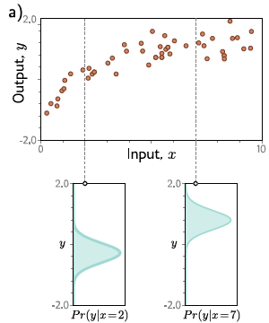
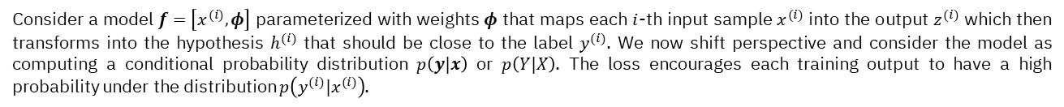
Lecture 6. Loss Functions. Uncertainty Estimation by Alexei Kornaev
Maximum likelihood
Consider a model $f=\left[x^{(i)}, φ\right]$ parameterized with weights $φ$ that maps each $i$-th input sample $x^{(i)}$ into the output $z^{(i)}$ which then transforms into the hypothesis $h^{(i)}$ that should be close to the label $y^{(i)}$. We now shift perspective and consider the model as computing a conditional probability distribution $p\left(y|x\right)$ or $p\left(Y|X\right)$. The loss encourages each training output to have a high probability under the distribution $p\left(y^{(i)}|x^{(i)}\right)$.
S. J. Prince. Understanding Deep Learning. MIT Press, 2023.
22

Slide 23
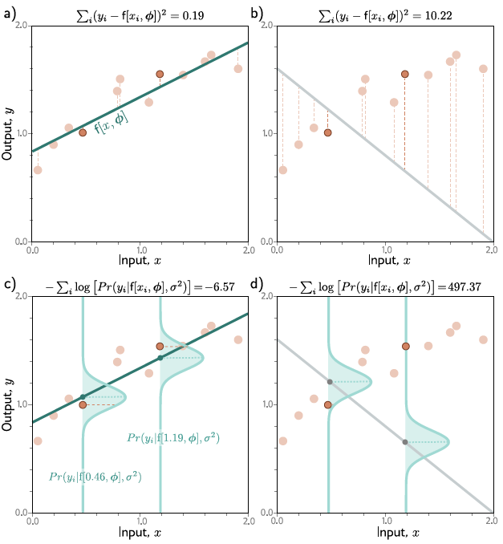
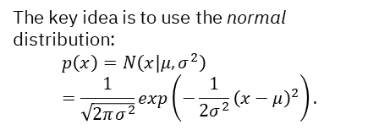
Lecture 6. Loss Functions. Uncertainty Estimation by Alexei Kornaev
Example 1: Regression (univariate, homoscedastic) and MSE loss
The key idea is to use the normal distribution:
$$p\left(x\right)=N\left(x|μ,σ^{2}\right)=\frac{1}{\sqrt{2πσ^{2}}}exp\left(−\frac{1}{2σ^{2}}{\left(x−μ\right)}^{2}\right).$$
S. J. Prince. Understanding Deep Learning. MIT Press, 2023.
23

Slide 24
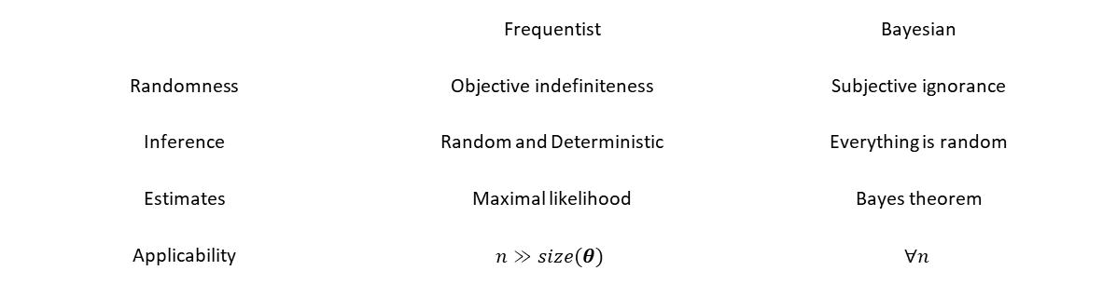
Lecture 6. Loss Functions. Uncertainty Estimation by Alexei Kornaev
Frequentist vs Bayesian frameworks
 | Frequentist | Bayesian
Randomness | Objective indefiniteness | Subjective ignorance
Inference | Random and Deterministic | Everything is random
Estimates | Maximal likelihood | Bayes theorem
Applicability | $$n≫size(θ)$$ | $$∀n$$
Deep Bayes School
24

Slide 25

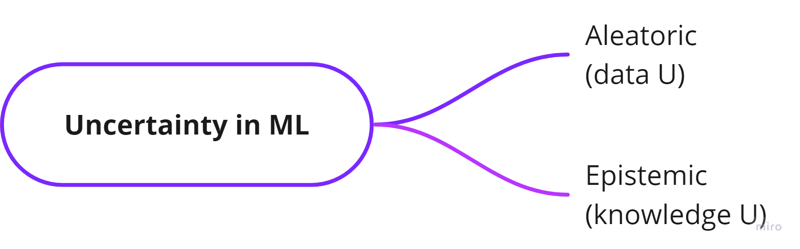
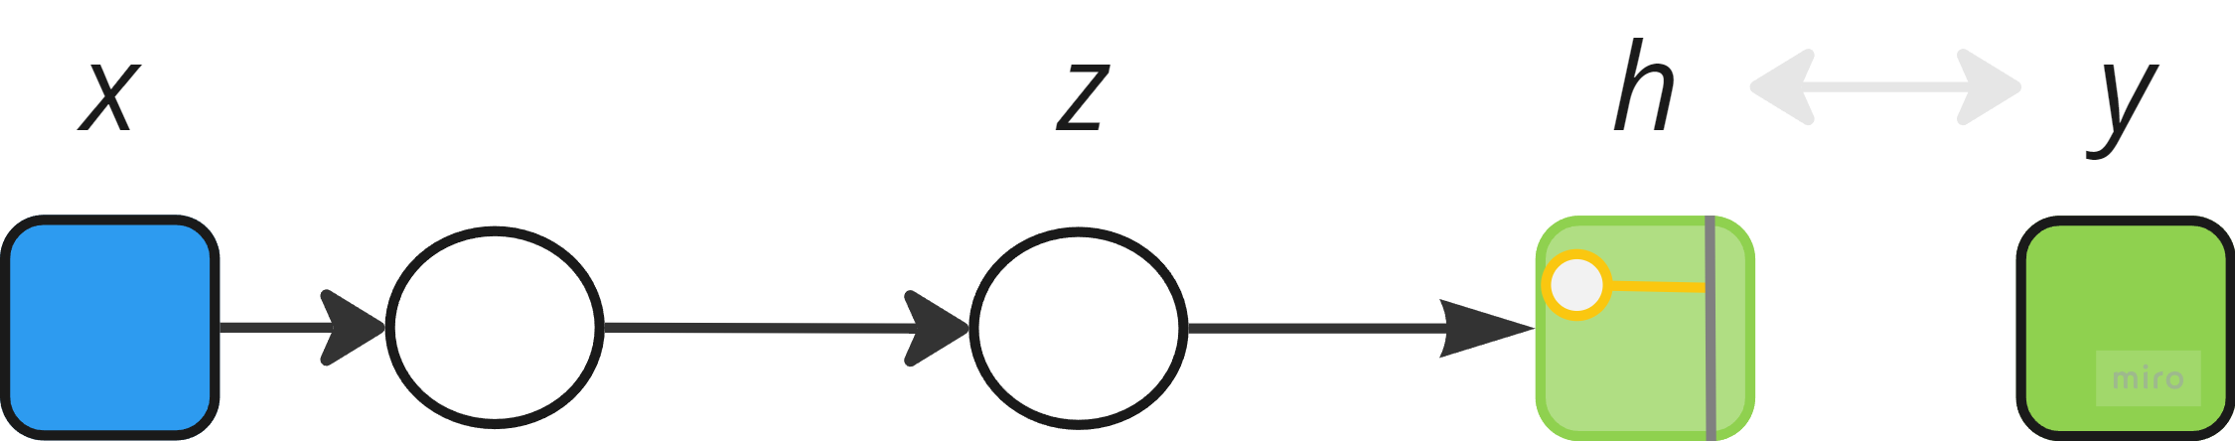
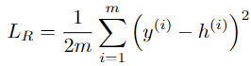
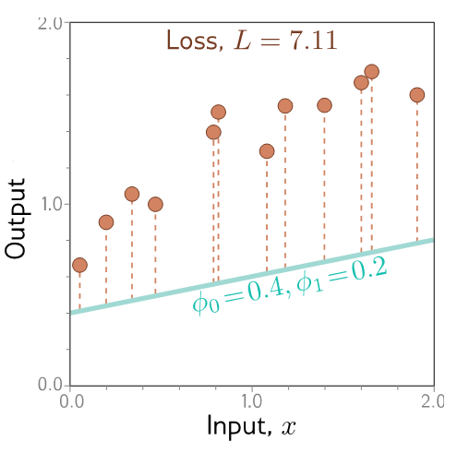
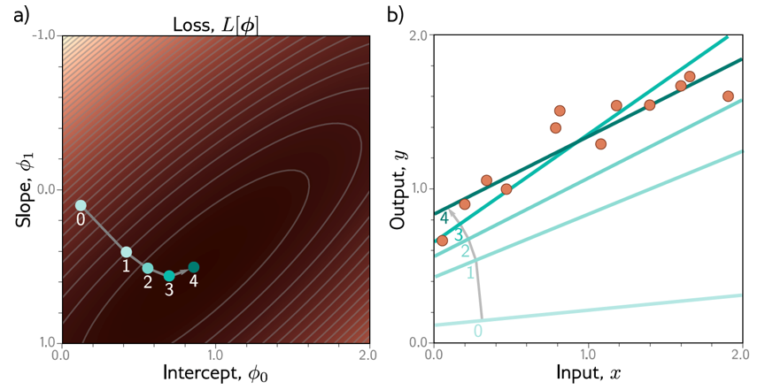
An uncertainty-aware loss intuition Homoscedastic regression vs heteroscedastic regression
Lecture 6. Loss Functions. Uncertainty Estimation by Alexei Kornaev
Model predicts output h given input x
Supervised learning intuition: S. J. Prince. Understanding Deep Learning. MIT Press, 2023. URL http://udlbook.com.

Slide 26

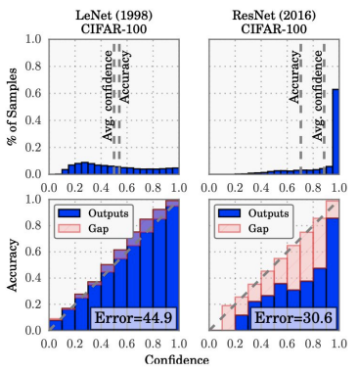
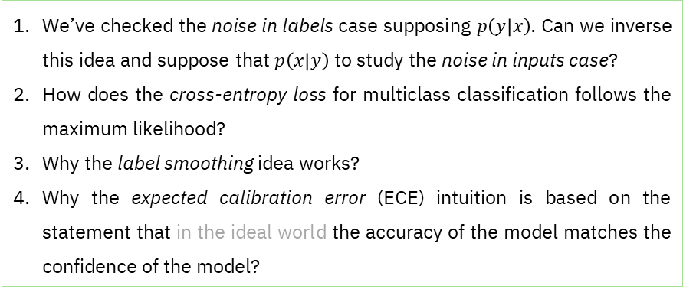
Lecture 6. Loss Functions. Uncertainty Estimation by Alexei Kornaev
Check up
### Summary
Generative models are powerful tools in AI with a wide range of applications, including data augmentation, anomaly detection, content creation, and simulation. They enable the creation of new data samples that mimic real-world data, enhancing the performance and capabilities of AI systems. However, they also face challenges related to computational complexity, quality and diversity trade-offs, training instability, evaluation difficulties, and ethical concerns. Addressing these challenges is crucial for the responsible and effective deployment of generative models in AI.
We’ve checked the noise in labels case supposing $p\left(y | x\right).$ Can we inverse this idea and suppose that $p\left(x | y\right)$ to study the noise in inputs case?
How does the cross-entropy loss for multiclass classification follows the maximum likelihood?
Why the label smoothing idea works?
Why the expected calibration error (ECE) intuition is based on the statement that in the ideal world the accuracy of the model matches the confidence of the model?
26

Slide 27

Lecture 6. Loss Functions. Uncertainty Estimation by Alexei Kornaev
Thank you for your attention!
a.kornaev@innopolis.ru, @avkornaev

Slide 28
ML-2024 Notes
28

Slide 29
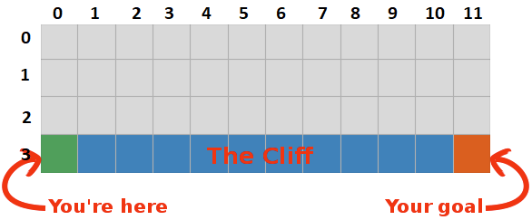
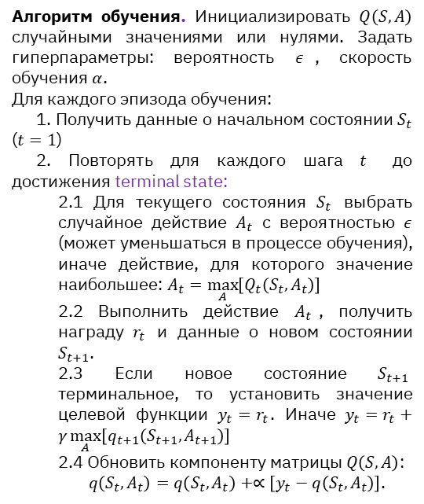
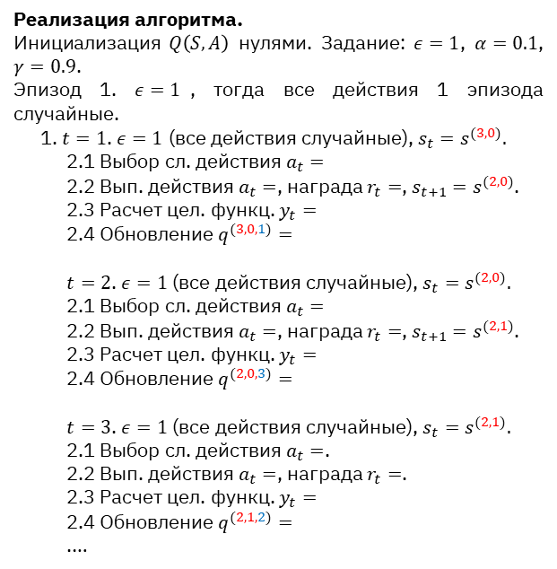
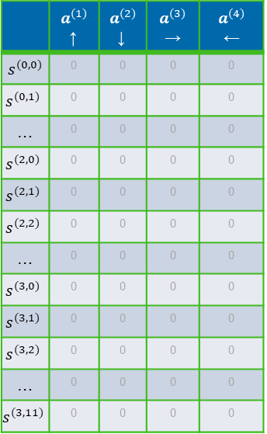
ML-2024 by Alexei Kornaev
 | $a^{(1)}$↑ | $a^{(2)}$↓ | $a^{(3)}$→ | $$a^{(4)}$$ ←
$s^{(0,0)}$ | 0 | 0 | 0 | 0
$$s^{(0,1)}$$ | 0 | 0 | 0 | 0
… | 0 | 0 | 0 | 0
$$s^{(2,0)}$$ | 0 | 0 | 0 | 0
$$s^{(2,1)}$$ | 0 | 0 | 0 | 0
$$s^{(2,2)}$$ | 0 | 0 | 0 | 0
… | 0 | 0 | 0 | 0
$$s^{(3,0)}$$ | 0 | 0 | 0 | 0
$$s^{(3,1)}$$ | 0 | 0 | 0 | 0
$$s^{(3,2)}$$ | 0 | 0 | 0 | 0
… | 0 | 0 | 0 | 0
$$s^{(3,11)}$$ | 0 | 0 | 0 | 0
Алгоритм обучения. Инициализировать $Q\left(S,A\right)$ случайными значениями или нулями. Задать гиперпараметры: вероятность $ε$, скорость обучения $α$.
Для каждого эпизода обучения:
1. Получить данные о начальном состоянии $S_{t}$ ($t=1$)
2. Повторять для каждого шага $t$ до достижения terminal state:
2.1 Для текущего состояния $S_{t}$ выбрать случайное действие $A_{t}$ с вероятностью $ε$ (может уменьшаться в процессе обучения), иначе действие, для которого значение наибольшее: $A_{t}=\max_{A}\left[Q_{t}\left(S_{t},A_{t}\right)\right]$
2.2 Выполнить действие $A_{t}$, получить награду $r_{t}$ и данные о новом состоянии $S_{t+1}$.
2.3 Если новое состояние $S_{t+1}$ терминальное, то установить значение целевой функции $y_{t}=r_{t}$. Иначе $y_{t}=r_{t}+γ\max_{A}\left[q_{t+1}\left(S_{t+1},A_{t+1}\right)\right]$
2.4 Обновить компоненту матрицы $Q\left(S,A\right)$:
$q\left(S_{t},A_{t}\right)=q\left(S_{t},A_{t}\right)+∝\left[y_{t}−q\left(S_{t},A_{t}\right)\right]$.
Реализация алгоритма.
Инициализация $Q\left(S,A\right)$ нулями. Задание: $ε=1$, $α=0.1$, $γ=0.9$.
Эпизод 1. $ε=1$, тогда все действия 1 эпизода случайные.
1. $t=1$. $ε=1$ (все действия случайные), $s_{t}=s^{(3,0)}.$
2.1 Выбор сл. действия $a_{t}=$
2.2 Вып. действия $a_{t}=$, награда $r_{t}=$, $s_{t+1}=s^{(2,0)}$.
2.3 Расчет цел. функц. $y_{t}=$
2.4 Обновление $q^{(3,0,1)}=$
$t=2$. $ε=1$ (все действия случайные), $s_{t}=s^{(2,0)}.$
2.1 Выбор сл. действия $a_{t}=$
2.2 Вып. действия $a_{t}=$, награда $r_{t}=$, $s_{t+1}=s^{(2,1)}$.
2.3 Расчет цел. функц. $y_{t}=$
2.4 Обновление $q^{(2,0,3)}=$
$t=3$. $ε=1$ (все действия случайные), $s_{t}=s^{(2,1)}.$
2.1 Выбор сл. действия $a_{t}=$.
2.2 Вып. действия $a_{t}=$, награда $r_{t}=$.
2.3 Расчет цел. функц. $y_{t}=$
2.4 Обновление $q^{(2,1,2)}=$
.…
29

Slide 30
Lecture 6. Loss Functions. Uncertainty Estimation Notes
30

Slide 31
Lecture 6. Loss Functions. Uncertainty Estimation Notes
31

Slide 32
Lecture 6. Loss Functions. Uncertainty Estimation Notes
32

